Slide 1
Advanced JavaScript Day-1

Slide 2
Contents
Event Bubbling and Capturing
Anonymous and Call-back functions
Closures
Function Overloading
Prototype
OOPs in JavaScript
Module Pattern

Slide 3
Event Bubbling and Capturing
Event bubbling and capturing are two ways of event propagation in HTML DOM.
Event bubbling
In bubbling the event is first captured and handled by the inner most element and then propagated to outer elements.
Event Capturing
In capturing the event is first captured by the outer most element and propagated to the inner most element.

Slide 4
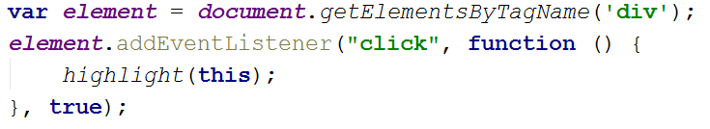
Event Bubbling and Capturing
How to bind events in Bubbling and Capturing phase.

Slide 5
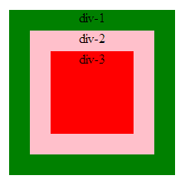
Event Bubbling and Capturing
Ex:

Slide 6
Event Bubbling and Capturing
Important Points
Only event bubbling model is supported by all the major browsers.
So if you are going to use event capturing still you need to handle event bubbling for IE. So it will easier to use event bubbling instead of capturing.

Slide 7
Anonymous and Call-backs functions
Anonymous Functions
Anonymous functions are functions that are dynamically declared at runtime.
These functions are not contain a name in the same way as normal functions.

Slide 8
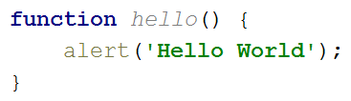
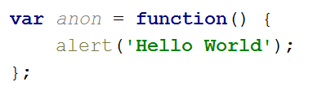
Anonymous and Call-backs functions
Normal function declaration
Anonymous function declaration

Slide 9
Anonymous and Call-backs functions
Callback Functions
Callback functions are the functions that are passed to another function as an argument.
Callback functions are probably the most widely used functional programming technique in JavaScript.

Slide 10
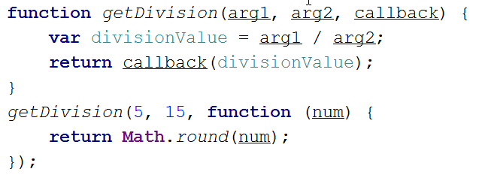
Anonymous and Call-backs functions
Ex1:

Slide 11
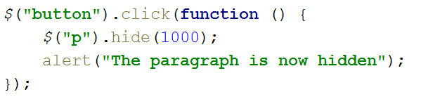
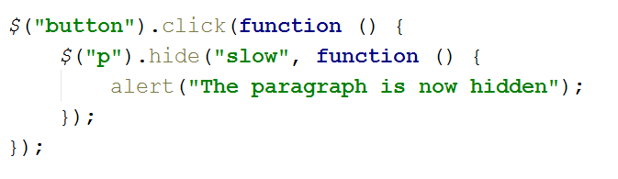
Anonymous and Call-backs functions
Ex2:
Ex3:

Slide 12
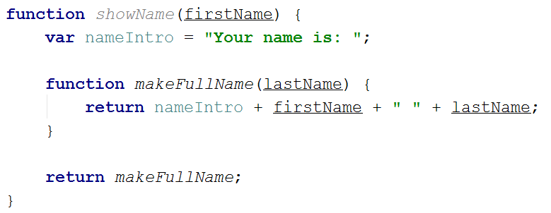
Closures
A closure is an inner function that has access to the outer (enclosing) function’s variables scope chain.
Ex1:

Slide 13
Function Overloading
Function or method overloading is declaring functions with the same name that accept different arguments thus have different behaviors depending on passed arguments.

Slide 14
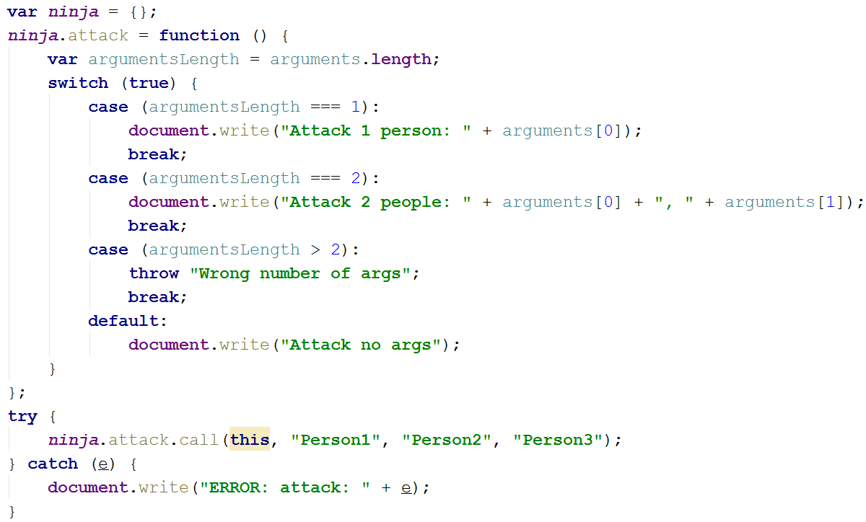
Function Overloading
Ex1:

Slide 15
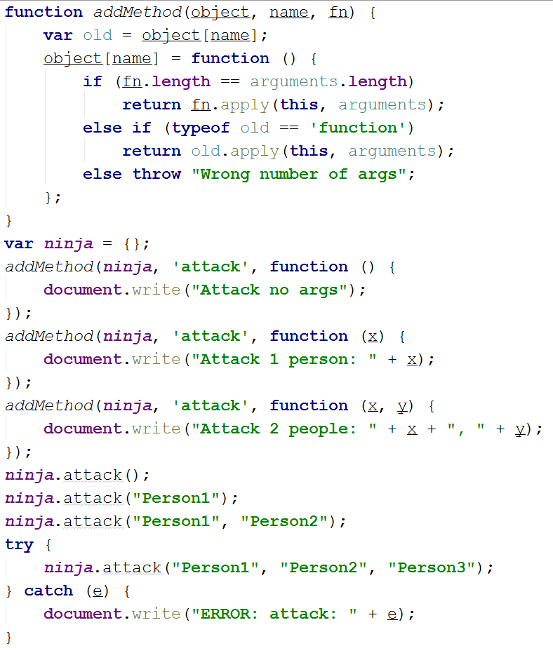
Function Overloading
Ex2:

Slide 16
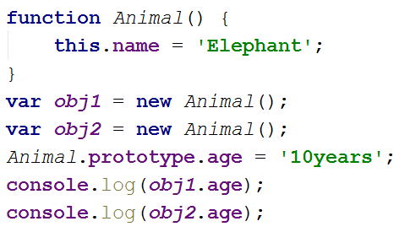
Prototype
When you define a function within JavaScript, it comes with a few pre-defined properties. One of these is the prototype.
Prototypes allow you to easily define methods to all instances of a particular object.
Ex:

Slide 17
OOPs in JavaScript
Object-oriented programming is intended to promote greater flexibility and maintainability in programming, and is widely popular in large-scale software engineering.
Concepts:
Class
Object
Property
Method
Constructor
Inheritance
Encapsulation
Abstraction
Polymorphism

Slide 18

OOPs in JavaScript
Class:
JavaScript is a prototype-based language which contains no class statement, such as is found in Php, C++ or Java.
Ex:

Slide 19
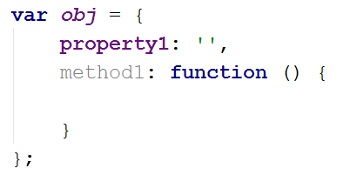
OOPs in JavaScript
Object:
An object is just a special kind of data, with properties and methods.
Ex1:

Slide 20
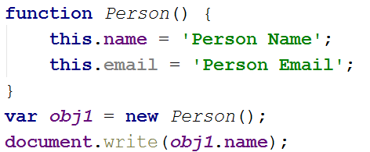
OOPs in JavaScript
Property:
Properties are variables contained in the class and every instance of the object has those properties.
Ex:

Slide 21
OOPs in JavaScript
Methods:
Methods follow the same logic as properties the difference is that they are functions and they are defined as functions.
Calling a method is similar to accessing a property, but you add () at the end of the method name, possibly with arguments.

Slide 22
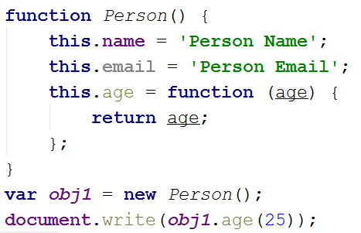
OOPs in JavaScript
Ex:

Slide 23
OOPs in JavaScript
Constructor:
The constructor is a method of the class.
Constructor method is called at the moment of instantiation.
In JavaScript, the function serves as the constructor of the object. therefore, there is no need to explicitly define a constructor method.

Slide 24
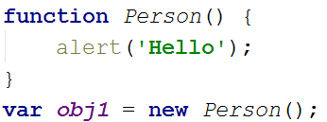
OOPs in JavaScript
Ex:

Slide 25
OOPs in JavaScript
Inheritance:
Inheritance is a way to create a class as a specialized version of one or more classes.

Slide 26
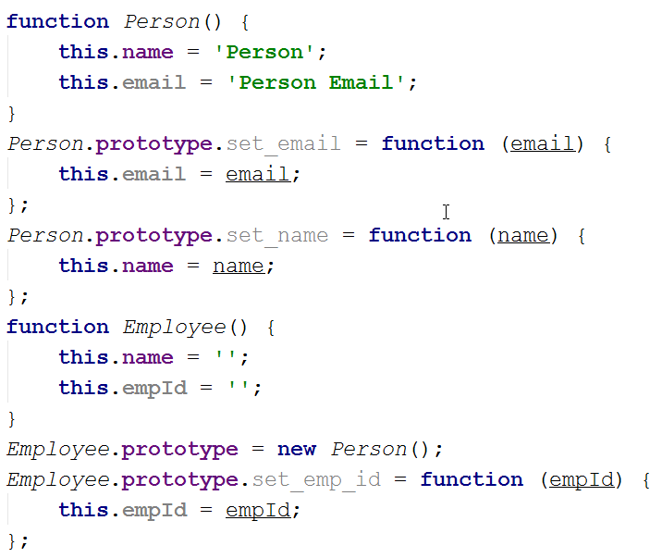
OOPs in JavaScript
Inheritance:
Ex:

Slide 27
OOPs in JavaScript
Encapsulation:
Encapsulation is a concept of hiding original implementation.
Ex:
In the previous example, Employee does not need to know how the Person class's set_email() and set_name() methods were implemented, but still can use those methods.
The Employee class doesn't need to explicitly define those methods unless we want to change it. This is called encapsulation.

Slide 28
OOPs in JavaScript
Abstraction:
Abstraction is a mechanism that permits modeling the current part of the working problem.
This can be achieved by inheritance (specialization), or composition.
JavaScript achieves specialization by inheritance, and composition by letting instances of classes is the values of attributes of other objects.

Slide 29
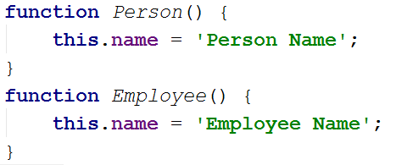
OOPs in JavaScript
Polymorphism:
Just like all methods and properties are defined inside the prototype property, different classes can define methods with the same name.
Ex:

Slide 30
Module Pattern
Modules are an integral part of any robust application's architecture and typically help in keeping the units of code for a project both cleanly separated and organized.
In JavaScript, there are several options for implementing modules.
These include:
The Module pattern
Object literal notation
AMD modules

Slide 31
Module Pattern
The Module pattern was originally defined as a way to provide both private and public encapsulation.
The Module pattern encapsulates "privacy", state and organization using closures.
It provides a way of wrapping a mix of public and private methods and variables, protecting pieces from leaking into the global scope and accidentally colliding with another developer's interface.
With this pattern, only a public API is returned, keeping everything else within the closure private.

Slide 32
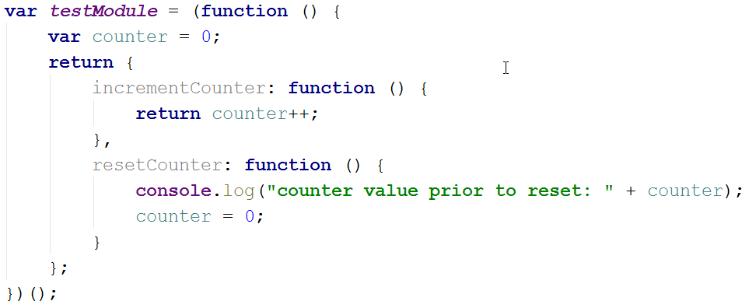
Module Pattern
Ex:

Slide 33

Module Pattern
Usage:

